Slide 1
Lecture 12.5 Contracting with distributors

Slide 2
Contracting with Distributors
What is the optimal length of a contract?
long term contracts provide incentives for relationship-specific investments
but it is difficult to write and enforce long term contracts when there is substantial uncertainty
use long term contracts when firm-specific investments are needed and the investment climate is stable
vertical integration might be preferred if firm-specific investments are needed and the outlook is uncertain

Slide 3
Contracting with Distributors
Similar issues apply in the firm’s relationships with distributors.
free rider problems
double marginalisation
A distributor has an incentive to free ride on the efforts of the manufacturer
advertising, service, sales effort
Potential solutions
vertical integration
partial vertical integration: e.g. the manufacturer takes over advertising
exclusive territories: grant the distributor market power in a region to improve incentives – but this exacerbates double marginalisation.

Slide 4
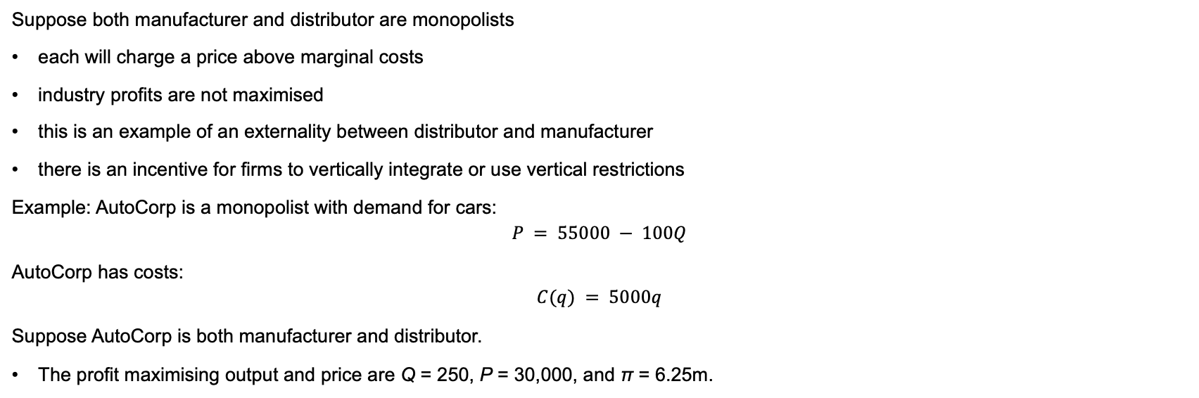
Double marginalisation
Suppose both manufacturer and distributor are monopolists
each will charge a price above marginal costs
industry profits are not maximised
this is an example of an externality between distributor and manufacturer
there is an incentive for firms to vertically integrate or use vertical restrictions
Example: AutoCorp is a monopolist with demand for cars:
$$P = 55000 − 100Q$$
AutoCorp has costs:
$$C(q) = 5000q$$
Suppose AutoCorp is both manufacturer and distributor.
The profit maximising output and price are Q = 250, P = 30,000, and π = 6.25m.

Slide 5
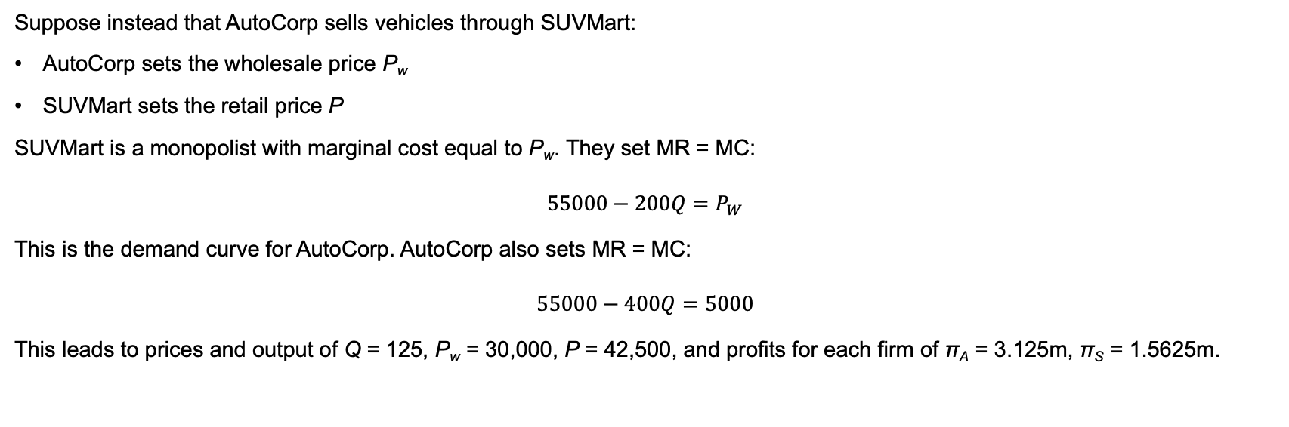
Double marginalisation
Suppose instead that AutoCorp sells vehicles through SUVMart:
AutoCorp sets the wholesale price P_{w}
SUVMart sets the retail price P
SUVMart is a monopolist with marginal cost equal to P_{w}. They set MR = MC:
$$55000−200Q=P_{W}$$
This is the demand curve for AutoCorp. AutoCorp also sets MR = MC:
$$55000−400Q=5000$$
This leads to prices and output of Q = 125, P_{w} = 30,000, P = 42,500, and profits for each firm of π_{A} = 3.125m, π_{S} = 1.5625m.

Slide 6
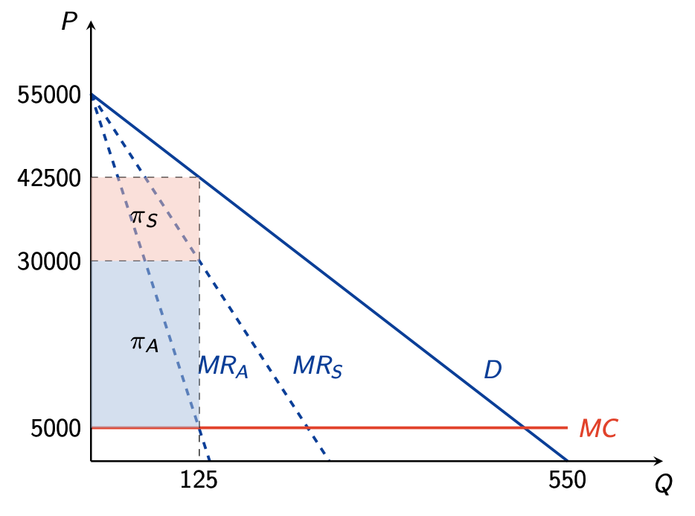
Double marginalisation

Slide 7
Double marginalisation
When AutoCorp sells directly to public they look at the demand curve for vehicles and choose price/ quantity to maximise profit.
When they sell via SUVMart, if they set the wholesale price equal to MC then SUVMart captures all the profits. To capture some of the profits AutoCorp increase the price at which they sell to SUVMart and in turn reduce the amount that SUVMart sells as the local monopolist.
Total profits will be lower in the latter case
How to solve this problem?
It would be possible, for example, for AutoCorp to set a two part tariff
For example, an upfront ‘franchise fee’ of $3.125m what would AutoCorp do?

